Slide 1


Advanced Database Management Systems
Lecture 3

Slide 2
SQL CLAUSES
Join clause
Inner Join
Outer Join
Cross Join
Self Join

Slide 3
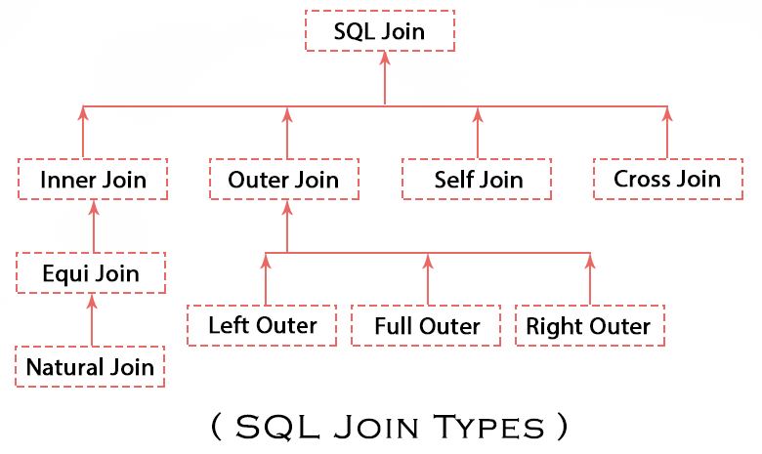
SQL Join Clause
In Relational Database,JOIN is used to combine columns from one or more tables.
There must be some common identifiers that allow information from multiple tables to be combined easily.

Slide 4
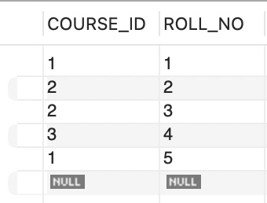
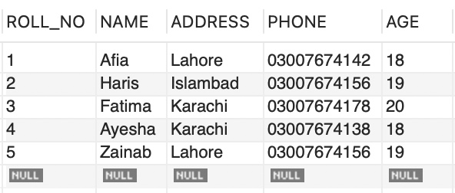
SQL Join Example
Consider the two tables below as follows:
Table 1: Studentt Table 2: std_courses

Slide 5
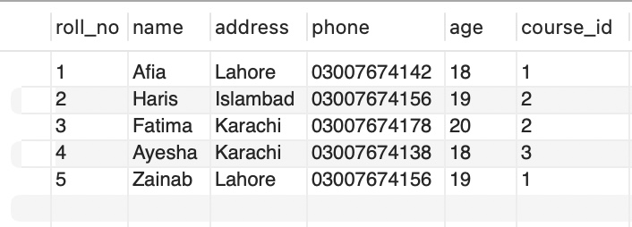
SQL Join Example(Cont...)
We can perform a JOIN operation using the given SQL query:
Query:
SELECT s.roll_no, s.name, s.address, s.phone, s.age, sc.course_id
FROM studentt s
JOIN std_courses sc ON s.roll_no = sc.roll_no;
Output:

Slide 6
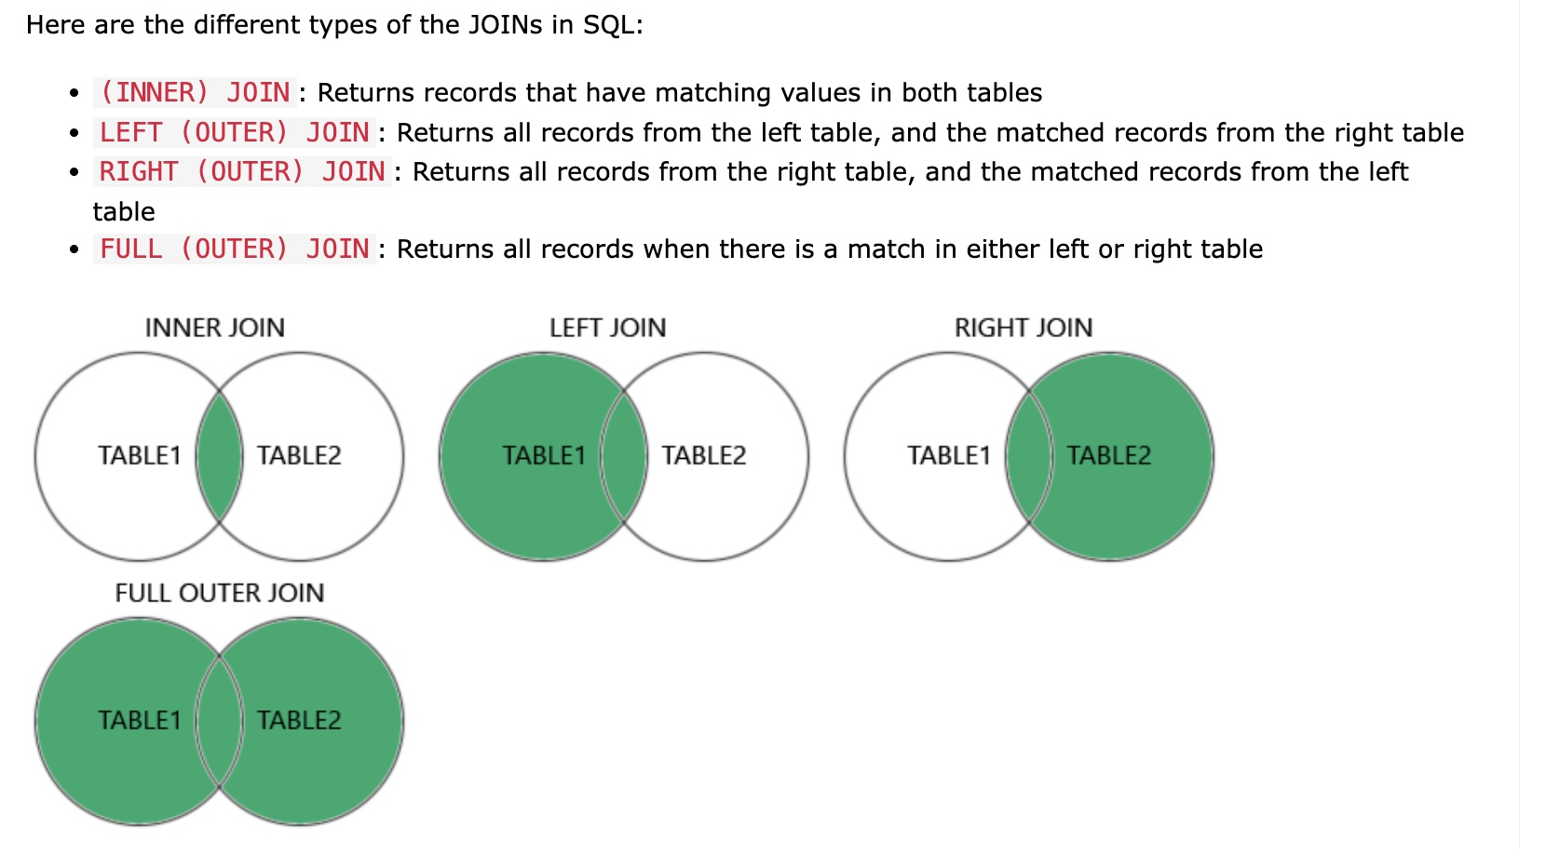
Different Types of SQL Joins

Slide 7
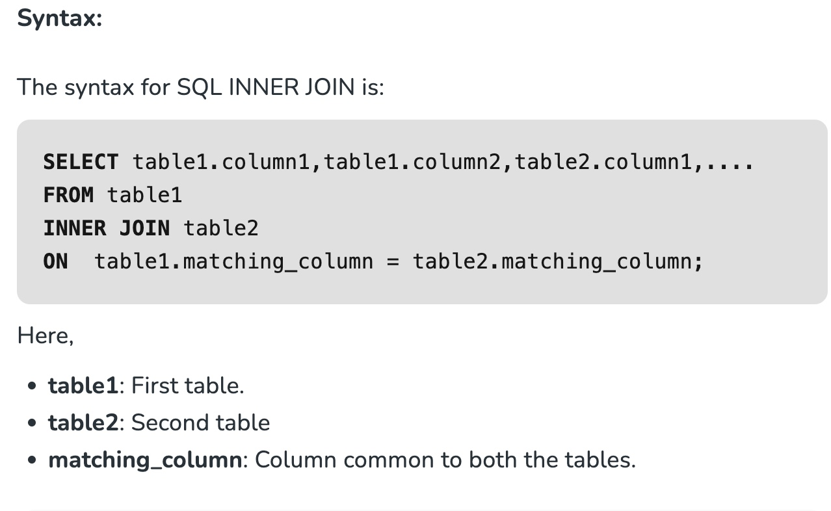
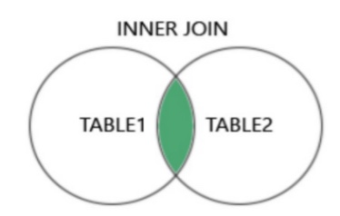
SQL INNER JOIN
The INNER JOIN keyword selects all rows from both the tables as long as the condition is satisfied. This keyword will create the result-set by combining all rows from both the tables where the condition satisfies i.e value of the common field will be the same.

Slide 8
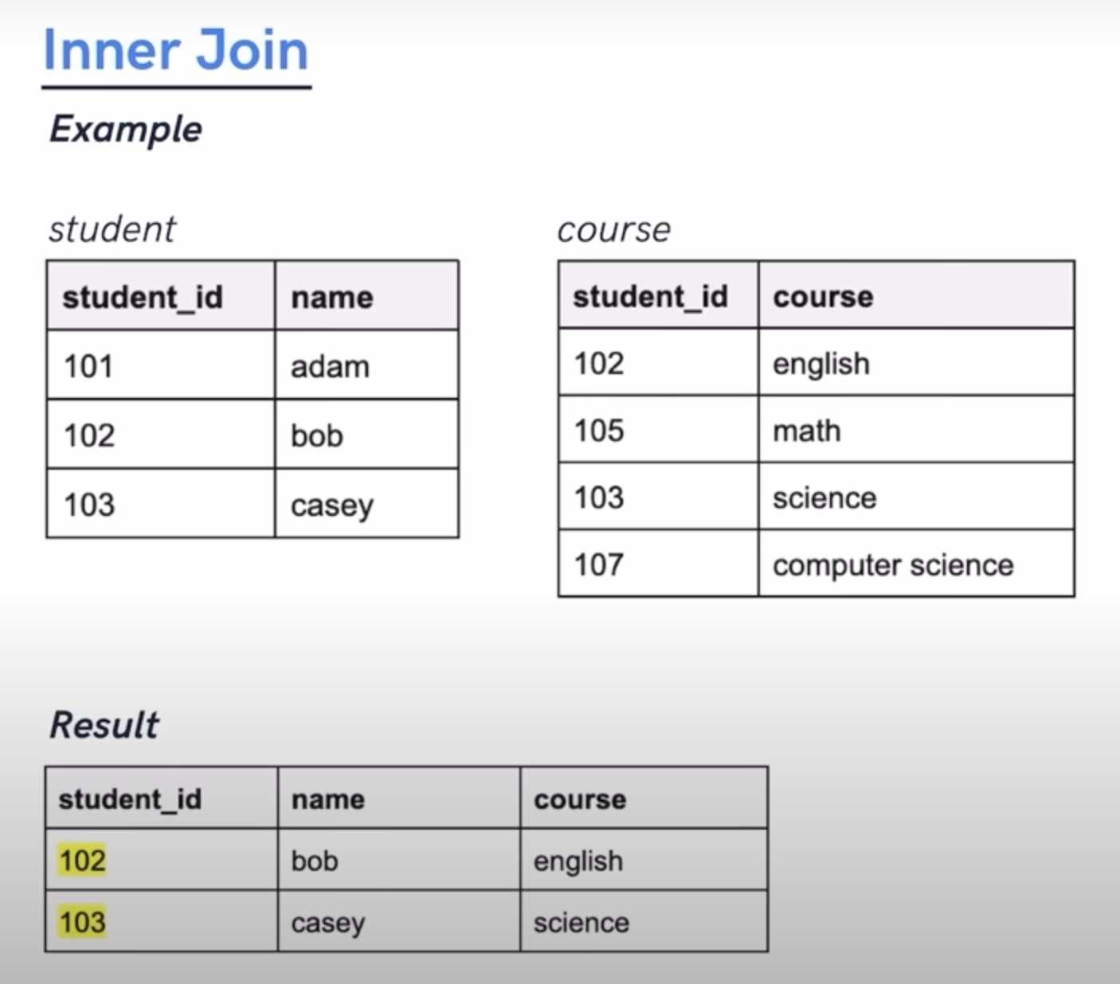
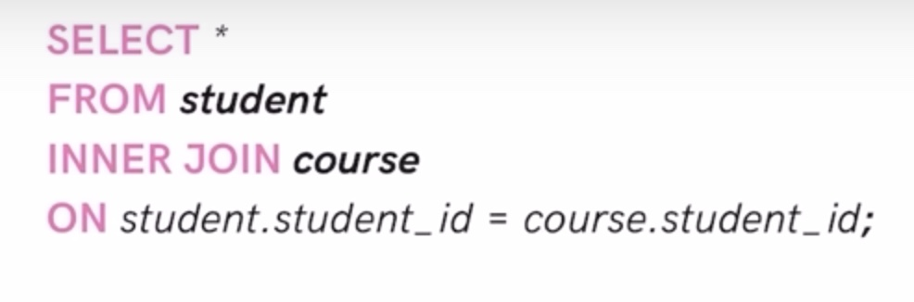

Slide 9
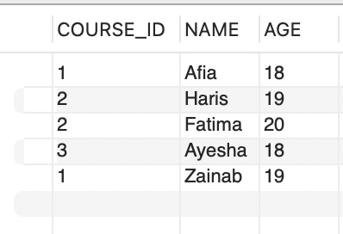
SQL INNER Join Example 2
Write a query that will show the names and age of students enrolled in different courses.
Query:
SELECT std_courses.COURSE_ID, studentt.NAME, studentt.AGE FROM studentt
INNER JOIN std_courses
ON studentt.ROLL_NO = std_courses.ROLL_NO; Output:
Table1: Studentt Table2: std_courses

Slide 10
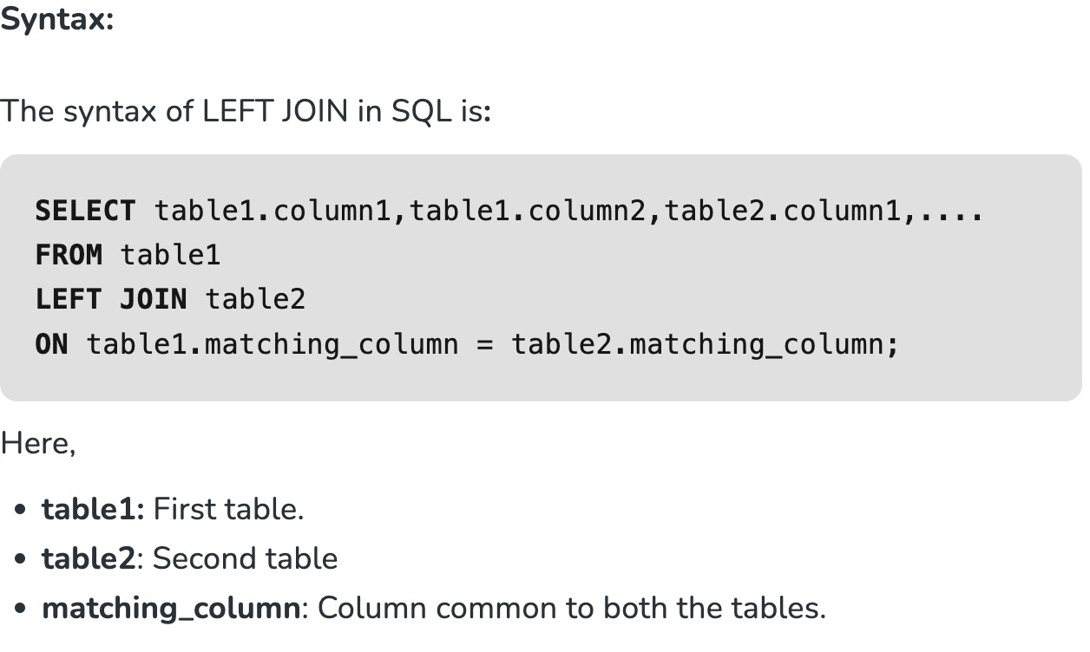
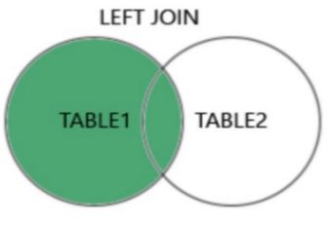
SQL Left(Outer) JOIN
LEFT JOIN returns all the rows of the table on the left side of the join and matches rows for the table on the right side of the join. For the rows for which there is no matching row on the right side, the result-set will contain null. LEFT JOIN is also known as LEFT OUTER JOIN.

Slide 11
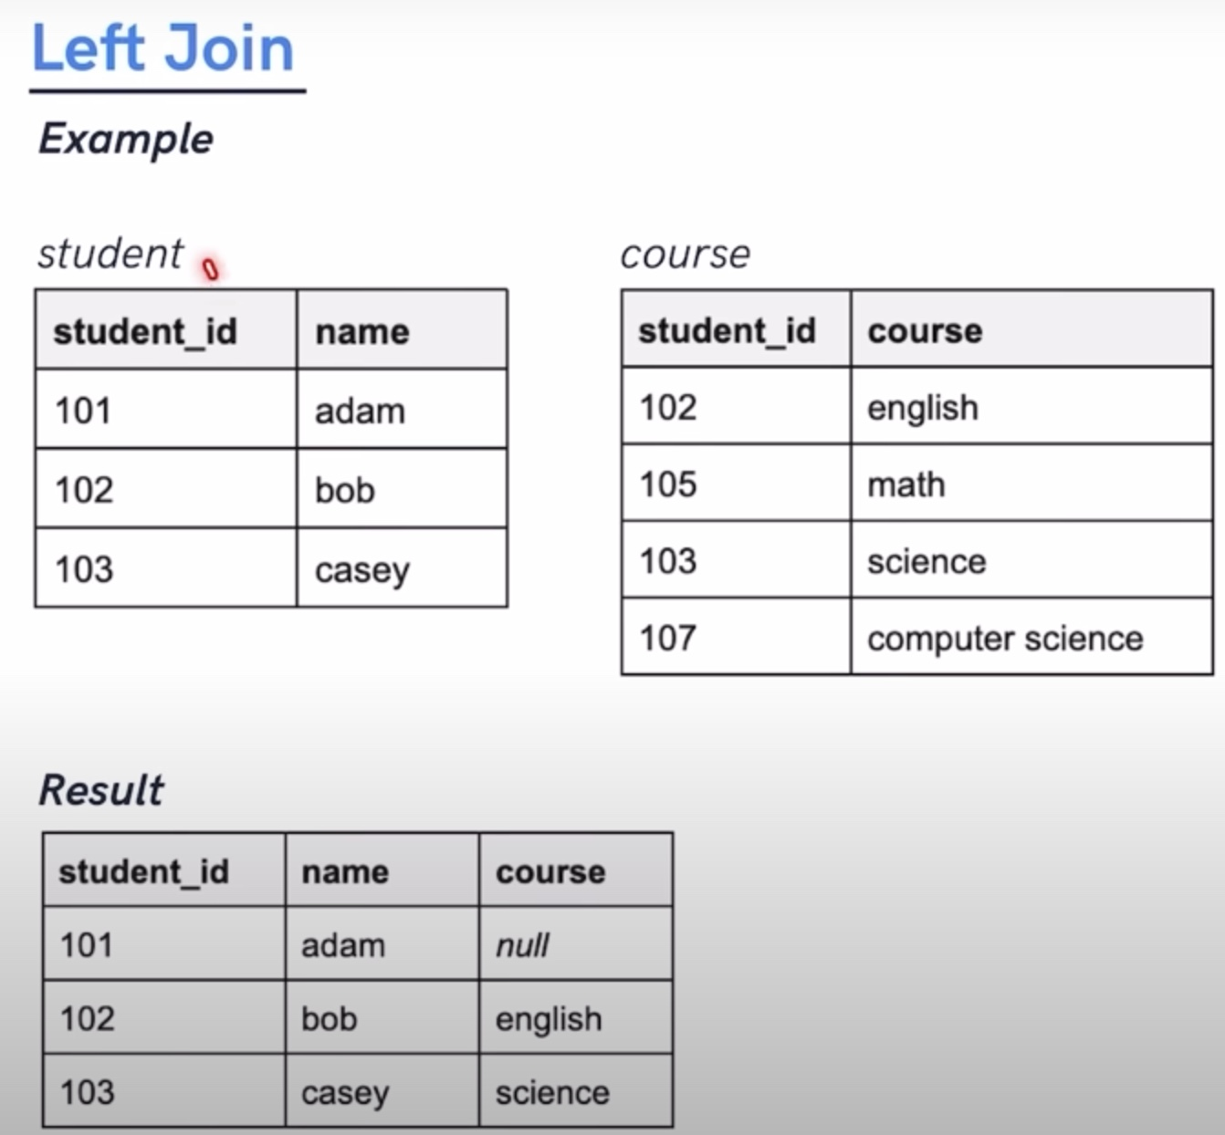
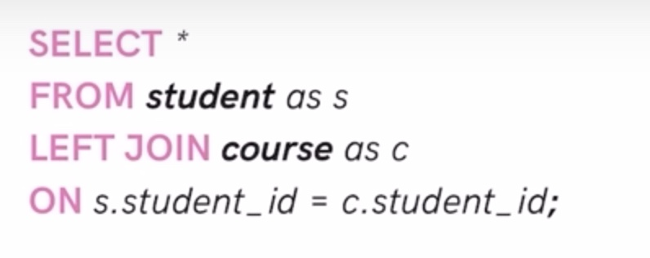

Slide 12
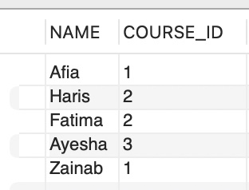
SQL Left(Outer) JOIN - Example 2
Write a query that wil show the names and course_ids of students.
Query:
SELECT studentt.NAME,std_courses.COURSE_ID
FROM studentt
LEFT JOIN std_courses
ON std_courses.ROLL_NO = studentt.ROLL_NO; Output:
Table1: Studentt Table2: std_courses

Slide 13
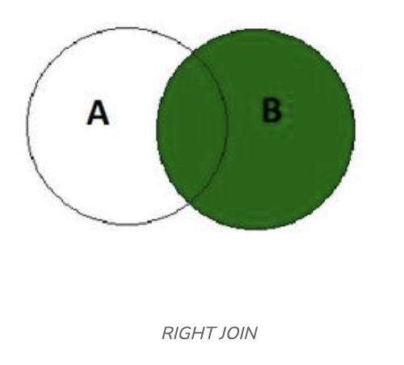
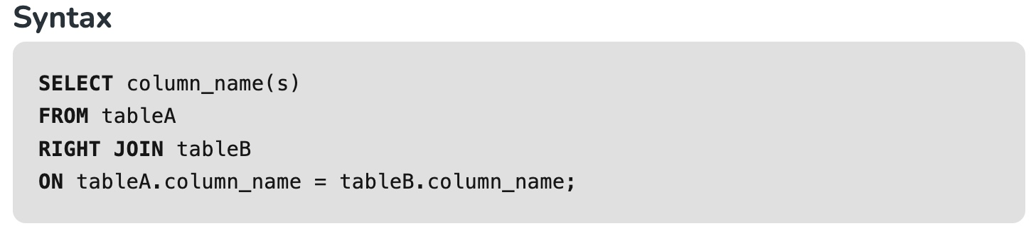
SQL Right JOIN
RIGHT JOIN returns all recoreds from the right table, and the mattched records from the left table.

Slide 14
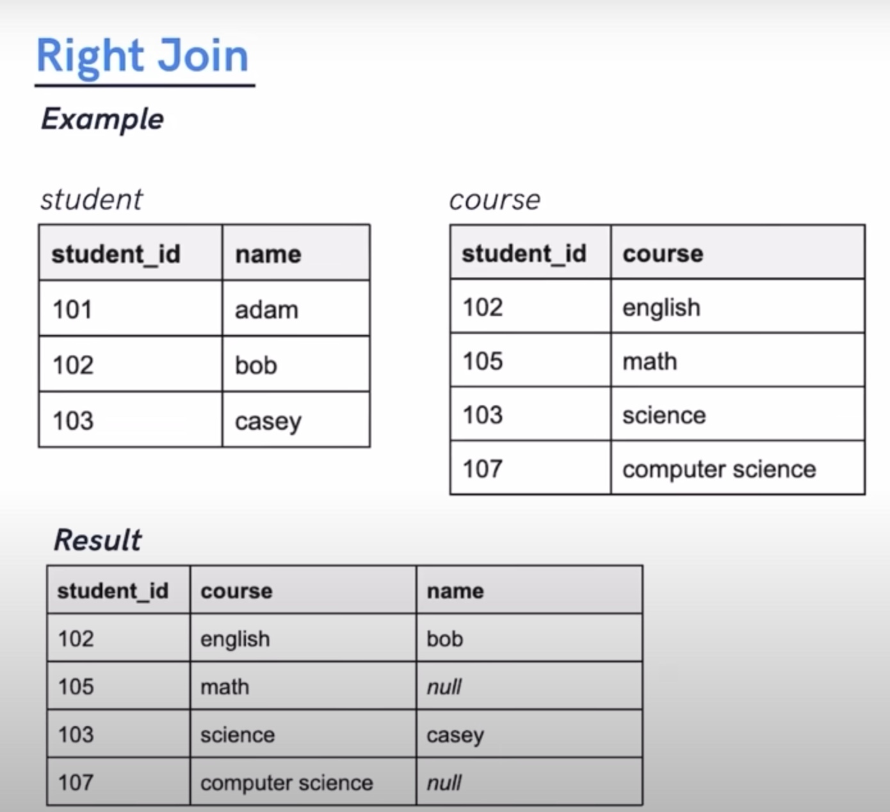
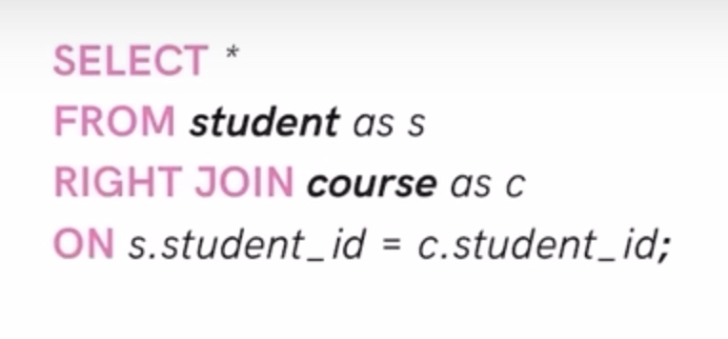

Slide 15
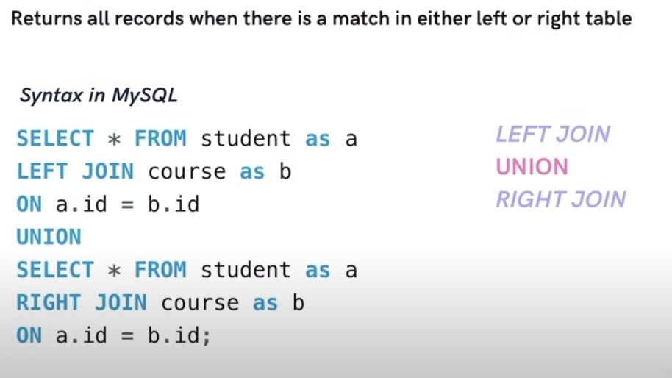
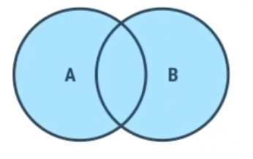
SQL FULL JOIN

Slide 16
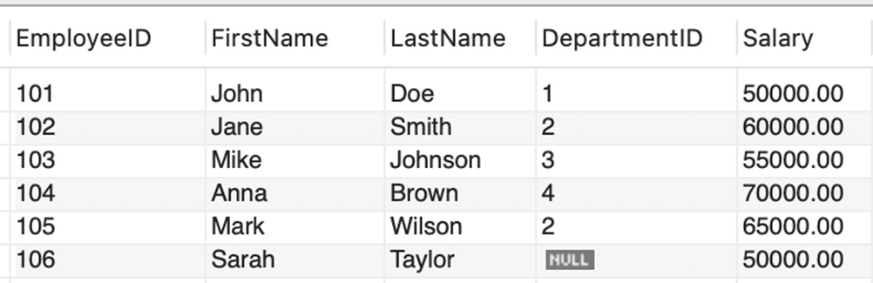
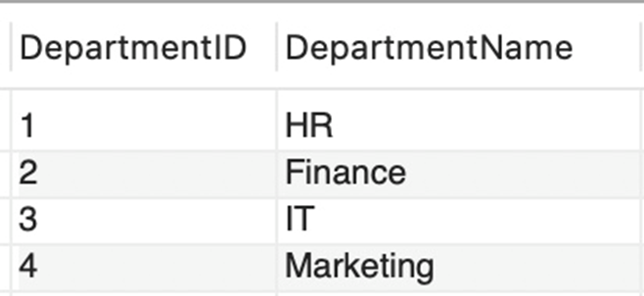
Create a database named CompanyDB.
Create Tables: Create two tables, Employees and Departments. The tables should have the following columns.
Table 1: Employees Table: Make EmployeeID as primary key
End of Lecture
Table 2 : Departments Table: Make DepartmentID as primary key

Slide 17
Q1: Display the employee details along with their department names using an INNER JOIN.
Q2: Display all employees, including those without a department, using a LEFT JOIN.
Q3: Display all departments, including those without any employees, using a RIGHT JOIN.
Q4: Display all possible combinations of employees and departments using Cross Join (Also menttion in comment about how cross join works)
Q5: Display pairs of employees who work in the same department. Identify the join type and apply it.

